Slide 1

Mine, Analyse and Visualize Healthcare Data

Slide 2
Mine, Analyse and Visualize Healthcare Data
Shashidar Ette
Student, MSc Advanced Software Engineering.
Informatics
University of Leicester
www.le.ac.uk

Slide 3
Agenda
Problem Domain
Project Aim
Datasets
Learning
Challenges
Demo

Slide 4
Problem Domain
Healthcare data available in public domain
Huge volumes of data
Multiple variables
Insights hidden within

Slide 5
Project Aim
Mine and analyze Practice level prescription Data
Data Exploration
Focus on Diabetes and related drug groups
Build Insights and correlation with other datasets
Notes:
That is, a person can sense the information and make changes to that information if desired. The level of interactivity can range from simply changing the physical perspective (e.g., seeing it from a different point of view) to manipulating and even creating new information.
A combination of real scene viewed by a user and a virtual scene generated by a computer is augmented with a real information.

Slide 6
Datasets
NHS-Digital
Practice level prescription data
CCG level prescription data
NHS BSA
Patient List Size including age demographics
GP Count
Public Health England
Health Indicators – disease prevalane
Index of Multiple Deprivation
Many more

Slide 7
Learning
Practices can be clustered based on average age, index of multiple deprivation, % of Diabetic patients
Correlation exists between costs, age, disease prevalence and measure of deprivation
Understand the variations between per patient cost and prescriptions costs overall
Build a system to assist data exploration by domain experts
Notes:
Tracking library (to recognize the fiducial markers or features)
Model loading and animation (to provide the AR elements of the game)
Game logic/game engine (i.e., something that provides the actual “game” of the application)
Rendering software to provide the images (visual, audio, etc.) to the display(s). Note that many game engines include rendering software as part of the game engine.
The software works by integrating three types of functionality:
Motion-tracking: using visual features of the environment, in combination with accelerometer and gyroscope data, to closely track the device's movements in space
Area learning: storing environment data in a map that can be re-used later, shared with other Tango devices, and enhanced with metadata such as notes, instructions, or points of interest
Depth perception: detecting distances, sizes, and surfaces in the environment

Slide 8
Challenges
Domain knowledge
Application of data science principles

Slide 9
Technology
Python for data analysis
Matplotlib and Plotly for visualization
HTML, CSS, Bootstrap, JavaScript and JSON for Application Prototype
Notes:
Tracking library (to recognize the fiducial markers or features)
Model loading and animation (to provide the AR elements of the game)
Game logic/game engine (i.e., something that provides the actual “game” of the application)
Rendering software to provide the images (visual, audio, etc.) to the display(s). Note that many game engines include rendering software as part of the game engine.
The software works by integrating three types of functionality:
Motion-tracking: using visual features of the environment, in combination with accelerometer and gyroscope data, to closely track the device's movements in space
Area learning: storing environment data in a map that can be re-used later, shared with other Tango devices, and enhanced with metadata such as notes, instructions, or points of interest
Depth perception: detecting distances, sizes, and surfaces in the environment

Slide 10
Demo
Application prototype demo
Cluster Analysis
General information
Parameter selection
Costs information
Chapter level
Drug group level

Slide 11
Questions

Slide 12
References
NHS Digital
NHS BSA
Public Health England Fingertips
OpenPrescribing.net, EBM DataLab, University of Oxford, 2017

Slide 13
Thank you

Slide 14
Next steps
To complete the data model for prescription cost prediction
Additional datasets should be explored:
Various health indicators provided by Public Health England
Other disease prevalence
Prescription cost analysis
Dispensing data (Pharmacies data) link it to prescriptions and practices.

Slide 15
Next steps
Configurable drug groups and trend dates
Aggregation and distribution of costs within Drug Group (Drill up and down)
To conduct user interactions with different stakeholders and understand the need for advanced visualizations.
- Work on the feedback provided by the end-users during the demo.

Slide 16
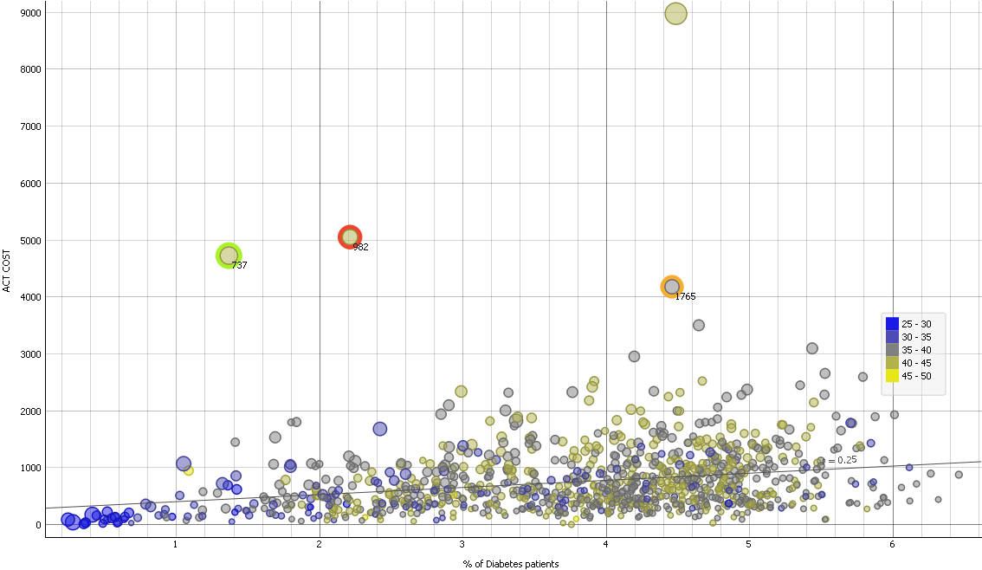
Interesting Insights

Slide 17
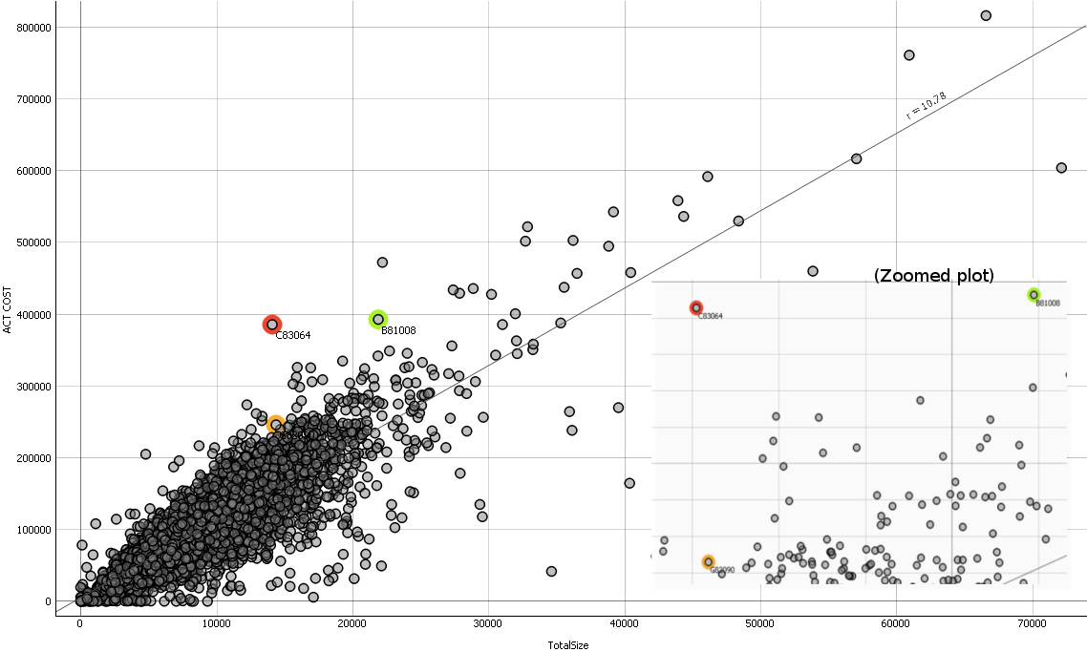
Interesting Insights

Slide 18
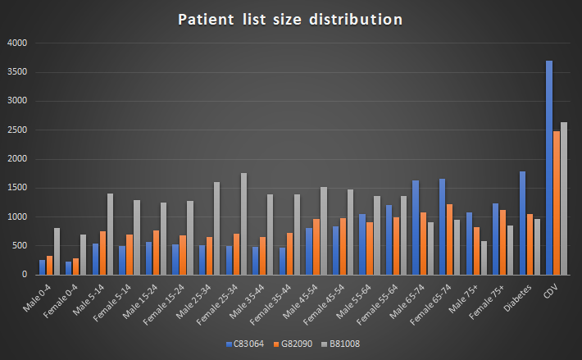
Interesting Insights

Slide 19
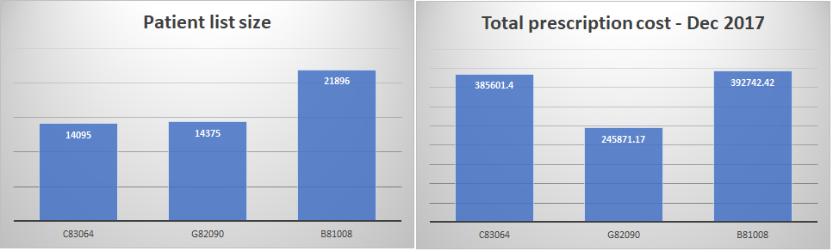
Interesting Insights

Slide 20
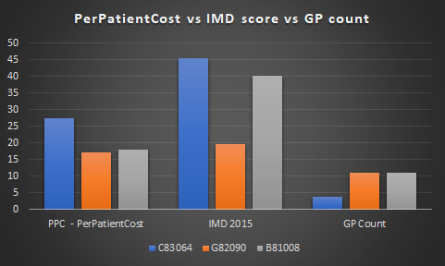
Interesting Insights

Slide 21
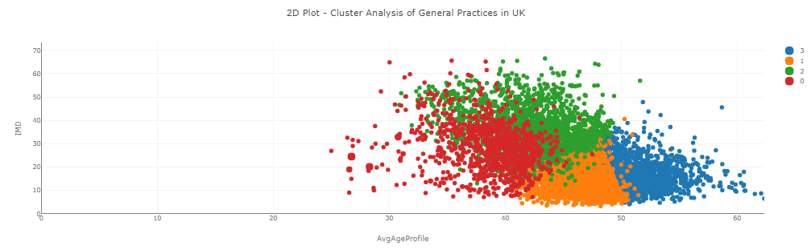
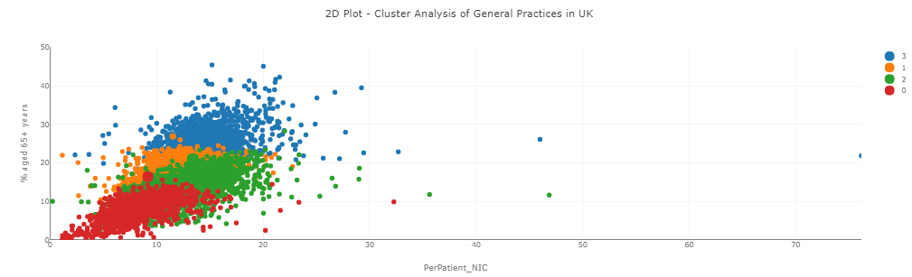
Interesting Insights

